Slide 1
Sisteme Tolerante la Defecte BIG Scale BIG Problems
Lect. Dr. Ing. Cristian Chilipirea – cristian.chilipirea@mta.ro

Slide 3

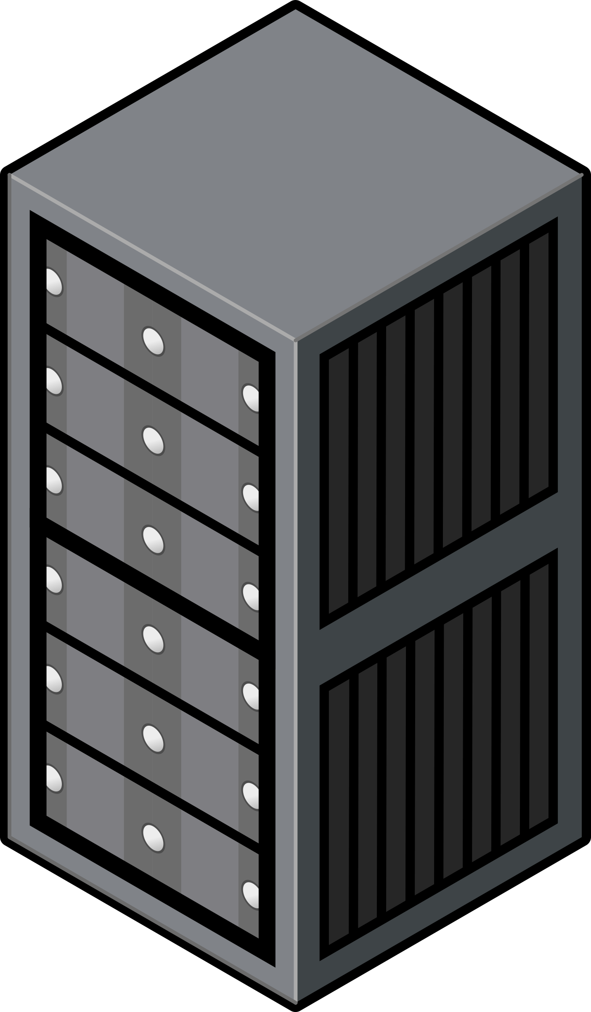

Load balancer

Slide 4
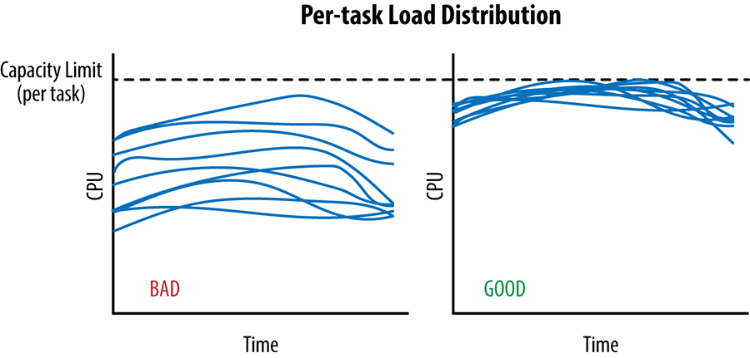
Load balancer
Picture from:SRE book

Slide 5
Load Balancer – Nivel Stivă Rețea (protocol)
TCP/UDP
HTTP/HTTPS
DNS

Slide 6
Load balancer - Algoritmi
Round Robin
Weighted Round Robin (Ratio)
Least Connections
Least Time
Weighted Least Connections
Random
Hash
IP Hash
Dynamic Ratio (based on load)

Slide 7
Load Balancer solutions
Hardware
Software: F5,
Software HTTP(S): Nginx
Software:
Docker Swarm – network overlay
Kubernetes load balancer
Cloud: Global Azure Load Balancer

Slide 8
Cache
Request

Slide 9
Cache
Request

Slide 10

Cache

Slide 11
Cache
Reply

Slide 12
Cache
Reply

Slide 13
Cache

Slide 14
Cache
Request

Slide 15
Cache
Reply

Slide 16
Tipuri de cache
Cache procesor
Server de cache (activ/pasiv)
Cache la client (în browser)
DNS cache

Slide 17
Probleme cache
Expirare
Spațiu limitat
Dacă este făcut la client, acesta decide politica
Mulți clienți cu același bug pot crea mari probleme

Slide 18
Cache replacement policies
Random
FIFO/LIFO
Least Recently Used/Most recently used
Least Frequently Used
Bélády (clairvoyant)

Slide 19
Content Delivery Network

Slide 20
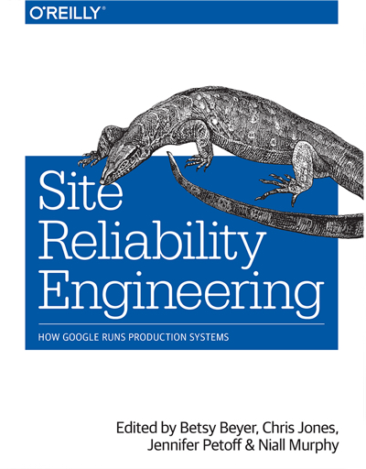
Site Relibability Engineering

Slide 21
Issues at scale
Configuration
Updates
Certificates
Software bugs
Cascading Failures

Slide 22
Traffic management
Retry
Exponential backoff
Noise
Throttling
Graceful degradation instead of service failure
Reject requests when overloaded
Deadlines (time to live)
Eliminate batch processes
Counterintuitive:
Stop health checks
Change queues to stacks

Slide 23
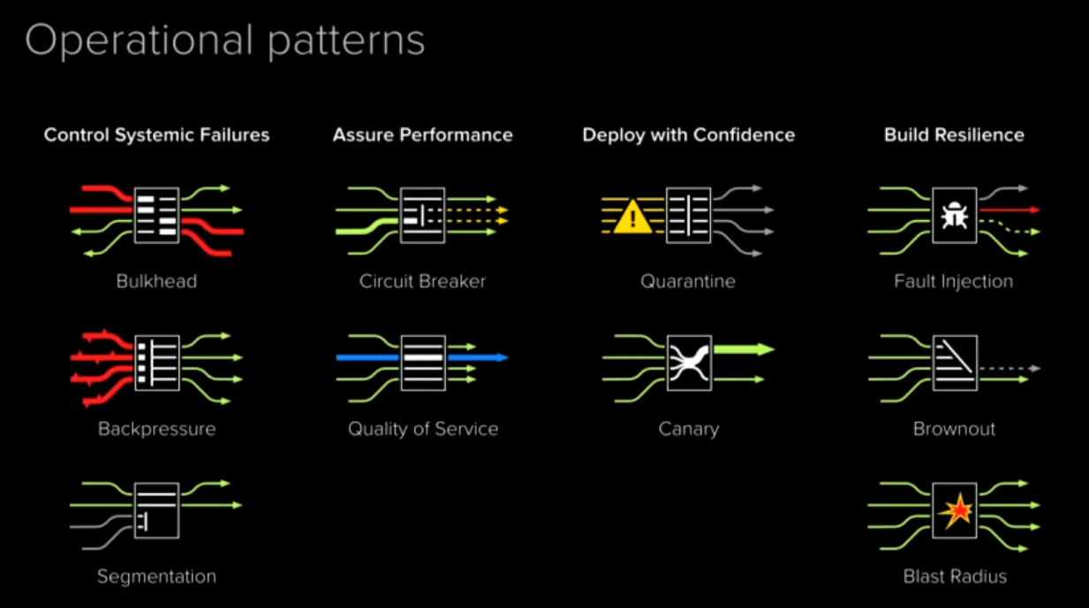
Operational patterns
InfoQ talk

Slide 24
Proceduri
Service Level Agreement (SLA)
Uptime 99.999% - five nines
Target și minim și maxim
Chaos Monkey
Postmortem – no blame
Mean Time To Repair
Mean Time Between Failures
Limitare timp on-call
Timp development (automatizare)

Slide 25
Monitorizare
White-box monitoring (din interiorul mașinii)
Black-box monitoring (din exterior)
Alerte
Semnale
Latency
Traffic
Errors
Saturation (cât de “full” sunt sistemele)
Colectare agregată și extensibilă pentru detalii

Slide 26
Testare
System Tests
Integration Tests
Unit Tests
Sanity Checking - Smoke Tests
Performance Tests –Stress test
Regression Tests
Canary Tests (faci update doar la o parte din infrastructură și autoamt rollback dacă sunt probleme)

